Slide 1
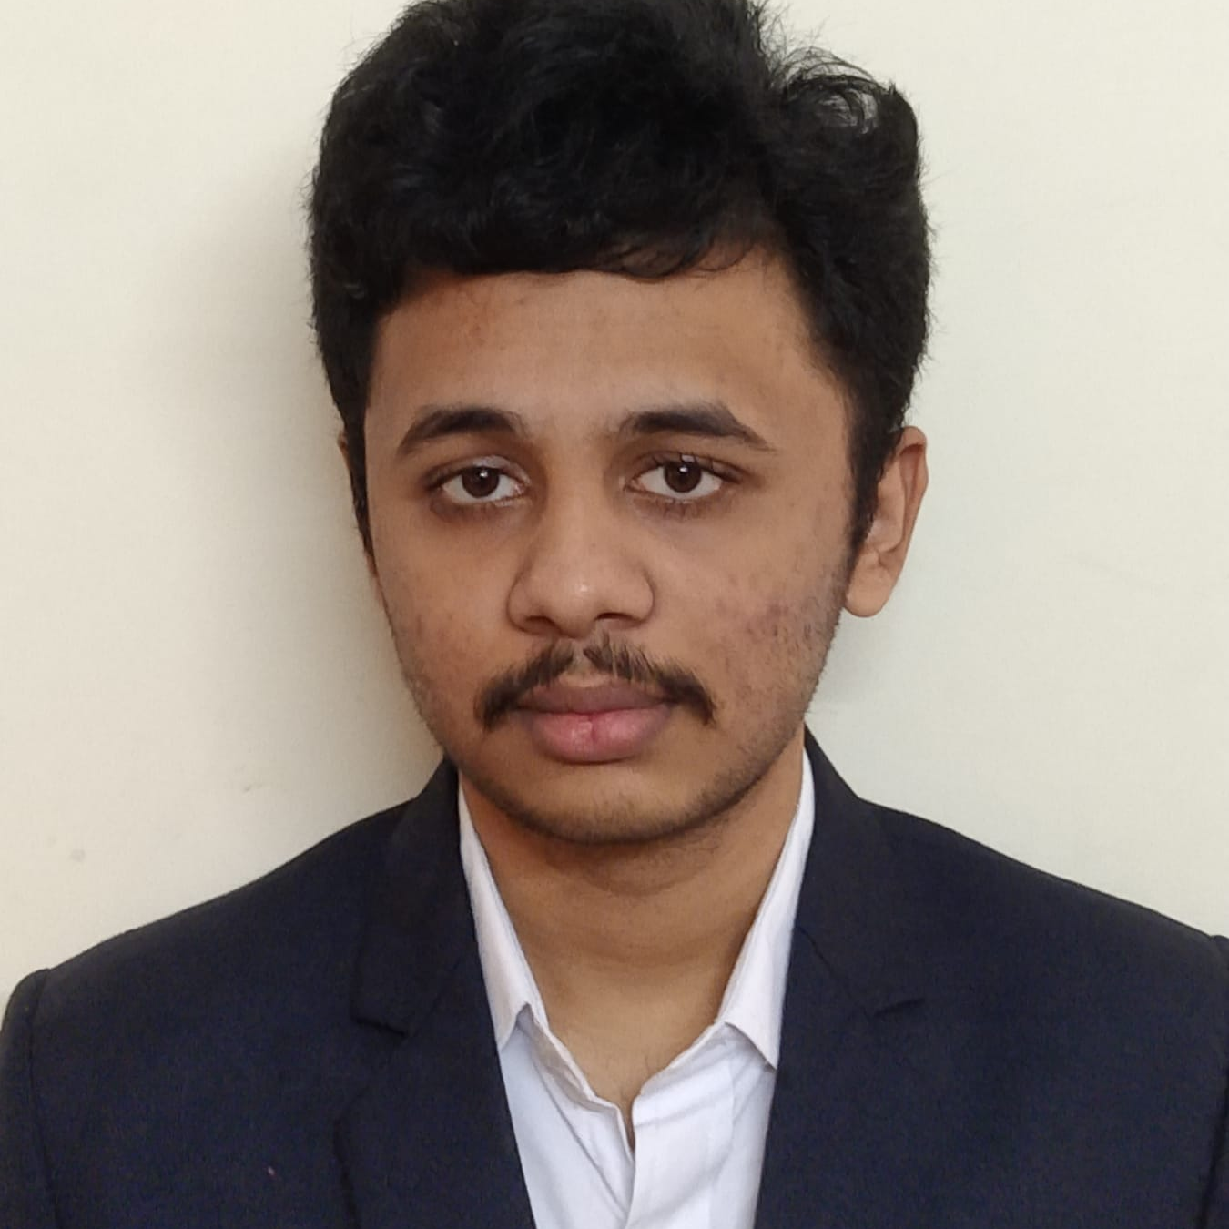

Sarath Chandra
Analyst/Software Engineer
Master of Computer Application
2020- 2022
Skills
Java OOPs, Collection, Generics, Exception Handling, Annotation Java 8- Lambda Function, Stream, Functional Interface JDBC
Backend
Spring Boot/Spring Security REST-API JPA CRUD
Database
MongoDB
Web Technologies
HTML5,CSS3
JavaScript React
Tools/IDE
IntelliJ IDEA
Eclipse
Visual Studio Code
Spring Tool Suite
AddOns
GitHub
Maven
Postman
Mumbai
chennamaraju.sarath-chandra@capgemini.com
+91 9380692660
A4
Full Stack Developer
Open to learn new technologies and ready to implement them to further improve my knowledge
Hands on experience in creating microservices with Springboot, Spring Security, Spring Cloud API Gateway, Eureka server.
Proficient in creating Single page Web Application in React .
React developer with working knowledge on ReactJS with react hooks, reactive forms, routing and Material UI.
Development experience using Eclipse,intellij,VS Code, postman Api connection and MongoDB by Atlas.
Deals and Coupons
Understood the requirement document for the case study and developed a backend application created base project using Spring Tool suit along with JWT authentication with payment feature and responsive UI for user interface
Railway Reservation Application​
Completed group case study on Railway Reservation application using Layered Architecture using spring boot with Swagger documentation, spring security with hibernate responsive UI with ReactJ

